Slide 1
Chapter Four: Storing and Retrieving Data
Android provides several options for you to save persistent application data.
The solution you choose depends on your specific needs
such as whether the data should be private to your application or accessible to other applications (and the user)
how much space your data requires.
The APIs you'll need to use a database on Android are available in the android.database.sqlite package.

Slide 2
Your data storage options are the following:
Shared Preferences
Store private primitive data in key-value pairs.
Internal Storage
Store private data on the device memory.
External Storage
Store public data on the shared external storage.
SQLite Databases
Store structured data in a private database.
Network Connection
Store data on the web with your own network server.

Slide 3
Android Internal Storage
We are able to save or read data from the device internal memory. FileInputStream and FileOutputStream classes are used to read and write data into the file.
Important Points about Internal Storage in Android
The stored data in memory is allowed to read and write files.
When files are stored in internal storage these file can only be accessed by the application itself not by other applications.
These files in storage exist till the application stays over the device, as you uninstall associated files get removed automatically.
The files are stored in directory data/data which is followed by the application
package name.

Slide 4
Android External Storage
Like internal storage, we are able to save or read data from the device external memory such as sdcard.
The FileInputStream and FileOutputStream classes are used to read and write data into the file.
Provide permission for the external storage
You need to provide the WRITE_EXTERNAL_STORAGE permission.
<uses-permission android:name="android.permission.WRITE_EXTERNAL_STORAGE"/>

Slide 5
SQLite
SQLite is an open-source relational database i.e. used to perform database operations on android devices such as storing, manipulating or retrieving persistent data from the database.
It is embedded in android by default. So, there is no need to perform any database setup or administration task.
SQLiteOpenHelper class provides the functionality to use the SQLite database.

Slide 6
SQLite is
a Structure query base database
open source
light weight
no network access
standalone database.
It support embedded relational database features.

Slide 7
When We Need SQLite?
If you are developing embedded software for devices like mobile phones, televisions, home electronic devices, cameras, etc., then sqlite is a good choice.
It is free and easy to use.
SQLite is open source, no commercial license required to use.
SQLite does not require a server to perform operations.
No extra setup or administration needed, it is embedded with Android.

Slide 8
SQLite Supporting Data Types:
TEXT
INTEGER
REAL

Slide 9
SQLite Open Helper:
When the application runs the first time – this point, we do not have a database, so here in this class, you can create a database.
When the application is upgraded to a new schema – our database will still be on the old schema from the older edition version of the app.
We will have the option to alter or upgrade the database schema to match the needs of the app.

Slide 10
Creating a Database in Android
public DatabaseHelper(Context context) {
super(context, DB_NAME, null, DB_VERSION);
}
In order to write data to a database, we need to create our database first. To create a database in SQLite in Android, you need to create a subclass of the class SQLiteOpenHelper.
This class provides the functionality to create a database and calls a function that can be overridden by the derived class.
.

Slide 11
SQLiteOpenHelper constructor
The SQLiteOpenHelper constructor accepts four arguments, which are
Context – This is the context that will be used to create the database. (Here you can pass the Activity object.)
Name – The name of the new database file.
Factory – A cursor factory (you can usually pass this as null)
Version – The version of the database. This number is used to identify if there is an upgrade or downgrade of the database

Slide 12
on Create(SQLiteDatabase db) :
It’s called when there is no database and the app needs one and to create a new database.
on Upgrade(SQLiteDatabase db, int oldVersion, int newVersion) :
It’s called when the schema version we need does not match the new schema version of the database.

Slide 13
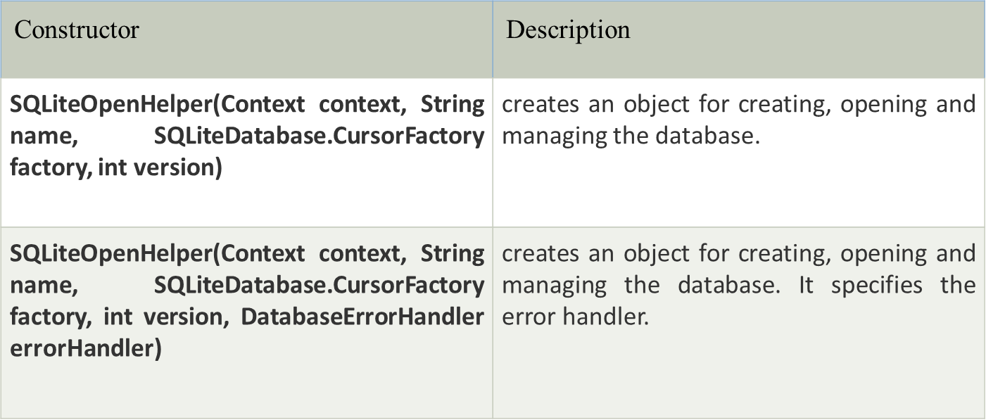
There are two constructors of SQLiteOpenHelper class.

Slide 14
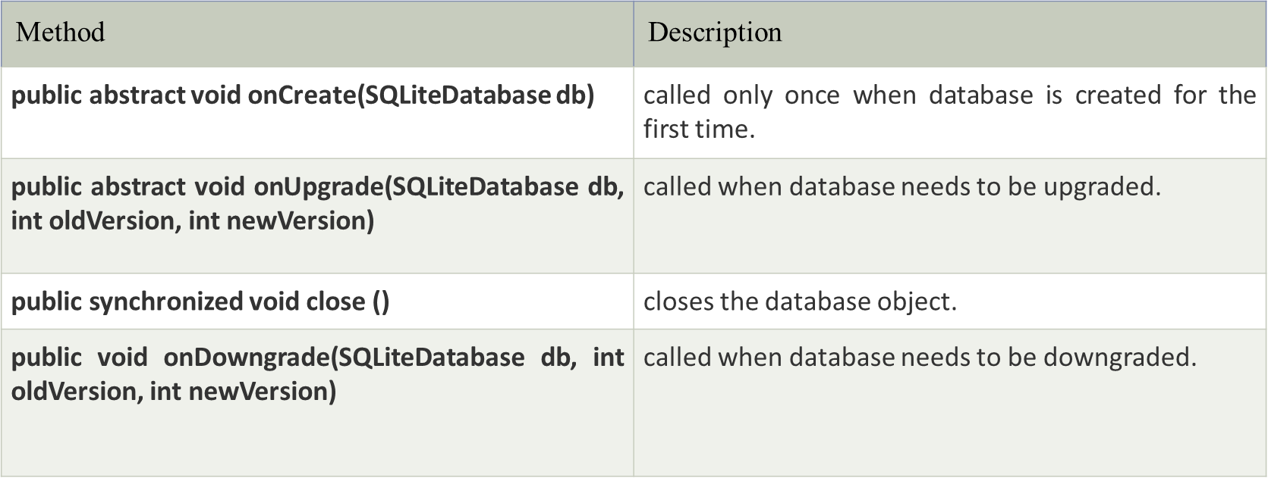
Methods of SQLiteOpenHelper class
There are many methods in SQLiteOpenHelper class. Some of them are as follows:

Slide 15
SQLiteDatabase class
It contains methods to be performed on sqlite database such as create, update, delete, select etc.
Methods of SQLiteDatabase class
There are many methods in SQLiteDatabase class. Some of them are as follows:

Slide 16
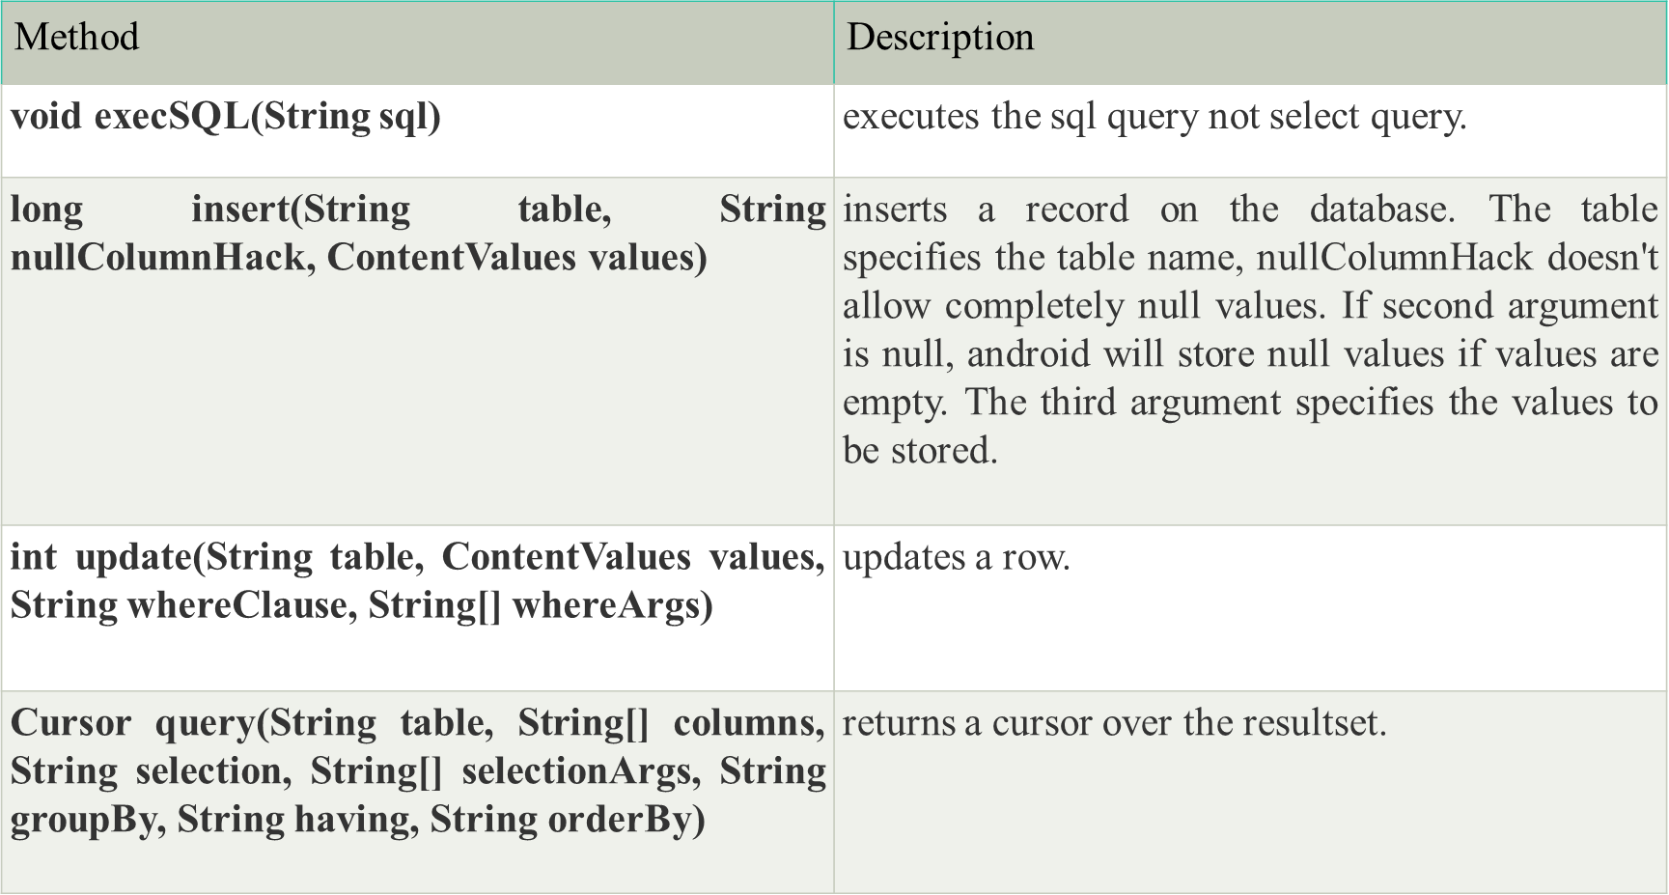

Slide 17
Put information into a database
Insert data into the database by passing a ContentValues object to the insert() method:
// Gets the data repository in write mode
SQLiteDatabase db = dbHelper.getWritableDatabase();
// Create a new map of values, where column names are the keys
ContentValues values = new ContentValues();
values.put(COLUMN_NAME_TITLE, title);
values.put(COLUMN_NAME_SUBTITLE, subtitle);
// Insert the new row, returning the primary key value of the new row
long newRowId = db.insert(TABLE_NAME, null, values);

Slide 18
The first argument for insert() is simply the table name.
The second argument tells the framework what to do in the event that the ContentValues is empty (i.e., you did not put any values).
If you specify the name of a column, the framework inserts a row and sets the value of that column to null. If you specify null, like in this code sample, the framework does not insert a row when there are no values.
The insert() methods returns the ID for the newly created row, or it will return -1 if there was an error inserting the data.
This can happen if you have a conflict with pre-existing data in the database.

Slide 19
Read information from a database
To query the database, we use the query() method along with appropriate arguments, most importantly the table name and the column names for which we are extracting values

Slide 20
To look at a row in the cursor, use one of the Cursor move methods, which you must always call before you begin reading values.
Since the cursor starts at position -1, calling moveToNext() places the "read position" on the first entry in the results and returns whether or not the cursor is already past the last entry in the result set.
For each row, you can read a column's value by calling one of the Cursor get methods, such as getString() or getLong().
For each of the get methods, you must pass the index position of the column you desire, which you can get by calling getColumnIndex() or getColumnIndexOrThrow().
When finished iterating through results, call close()

Slide 21
Delete information from a database
to delete rows from a table, you need to provide selection criteria that identify the rows to the delete() method.
The mechanism works the same as the selection arguments to the query() method.
It divides the selection specification into a selection clause and selection arguments.
The clause defines the columns to look at, and also allows you to combine column tests.
The arguments are values to test against that are bound into the clause.
Because the result isn't handled the same as a regular SQL statement, it is immune to SQL injection.

Slide 22
// Define 'where' part of query.
String selection = COLUMN_NAME_TITLE + " LIKE ?";
// Specify arguments in placeholder order.
String[] selectionArgs = { "MyTitle" };
// Issue SQL statement.
int deletedRows = db.delete(TABLE_NAME, selection, selectionArgs);
The return value for the delete() method indicates the number of rows that were deleted from the database.

Slide 23
Update a database
When you need to modify a subset of your database values, use the update() method.
Updating the table combines the ContentValues syntax of insert() with the WHERE syntax of delete().

Slide 24
SQLiteDatabase db = dbHelper.getWritableDatabase();
// New value for one column
String title = "MyNewTitle";
ContentValues values = new ContentValues();
values.put(COLUMN_NAME_TITLE, title);
// Which row to update, based on the title
String selection = COLUMN_NAME_TITLE + " LIKE ?";
String[] selectionArgs = { "MyOldTitle" };
int count = db.update(
FeedReaderDbHelper.TABLE_NAME,
values,
selection,
selectionArgs);
The return value of the update() method is the number of rows affected in the database.

Slide 25
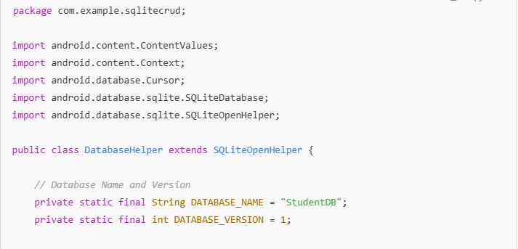
Example

Slide 26
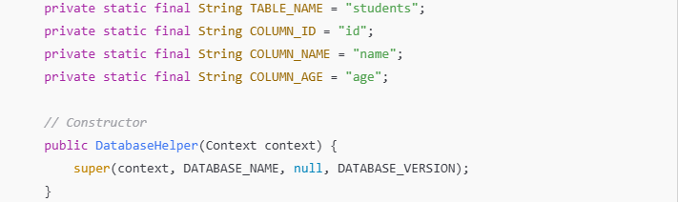
Example

Slide 27
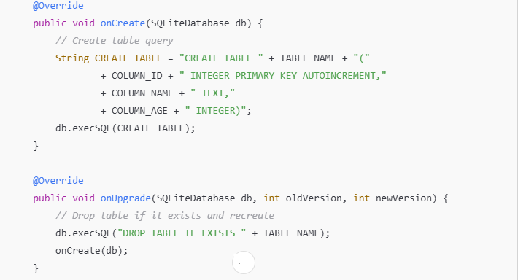
Example

Slide 28
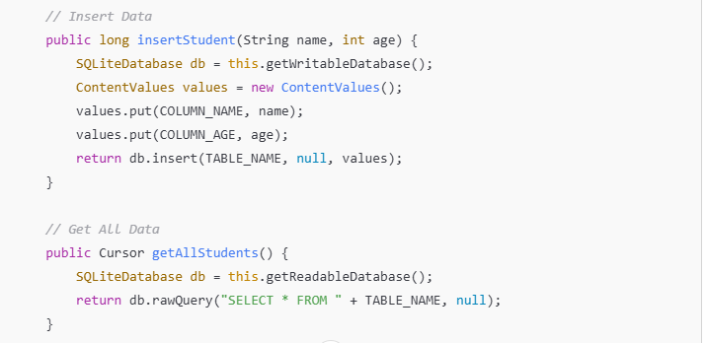
Example

Slide 29
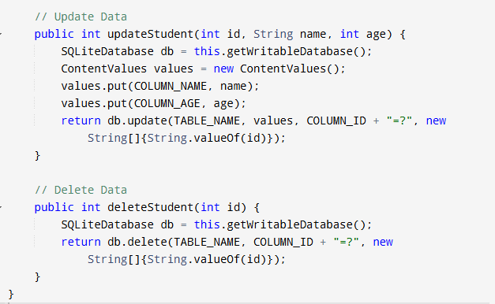
Example

